Slide 1
Paper Summary
Steven Lai

Slide 2
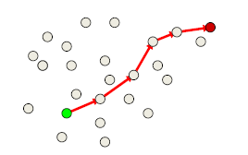
Greedy Routing with Guaranteed Delivery Using Ricci Flow
Greedy routing
Assign coordinates to nodes
Message moves to neighbor closest to destination
Simple, compact, scalable

Slide 3
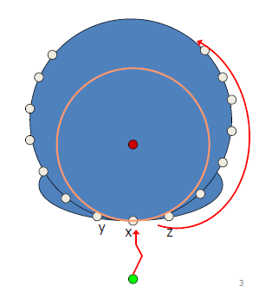
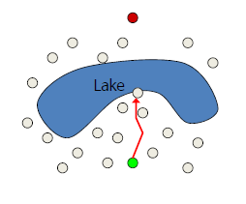
Problem: Greedy routing may get stuck
Can get stuck

Slide 4
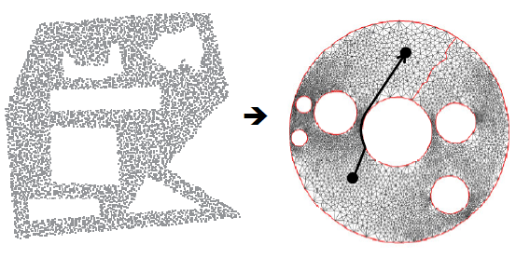
Solution: Use Ricci flow to make all holes circular
Greedy routing does not get stuck at holes.

Slide 5
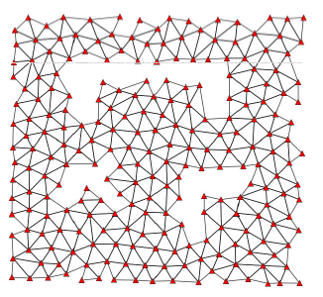
Ricci Flow in Sensor Networks
Build a triangulation from network graph
With node location: patch together the “local” Delaunay triangulations
Without locations: use landmark-based combinatorial Delaunay graph

Slide 6
Ricci Flow in Sensor Networks
All edge length = 1 initially
Introduces curvature in the surface
Use Ricci flow to reach target curvature k’
Take tangent circle packing metric: γ=1/2, φ=0 initially
Interior nodes: target curvature = 0
Nodes on boundary C: target curvature = - 2π/|C|
Modify ui = logγi by δ (κ’-κ)
Until the curvature difference < ε

Slide 7
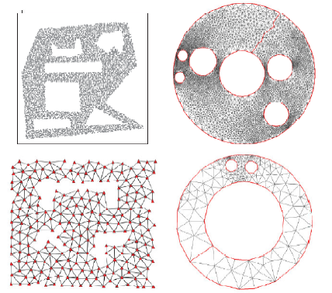
Results

Slide 8
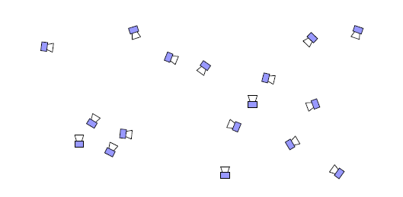
Distributed localization of networked cameras
Place wireless cameras around an environment
Need to know locations
Costly to measure locations

Slide 9
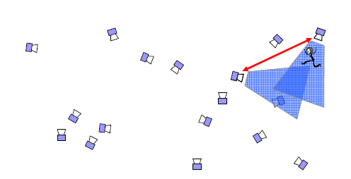
Distributed Localization of Cameras
If camera 1 sees person, then camera 2 sees person, learn about relative positions of cameras
As person moves around, estimate positions of all cameras

Slide 10
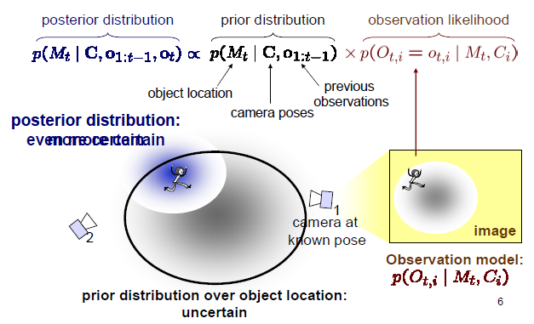
Tracking with Kalman Filter: Estimation

Slide 11
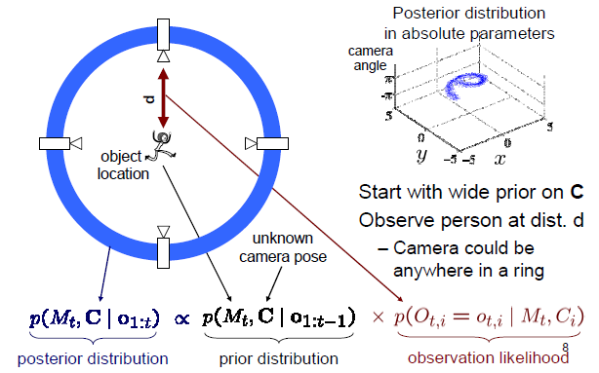
Camera Localization: Estimation

Slide 12
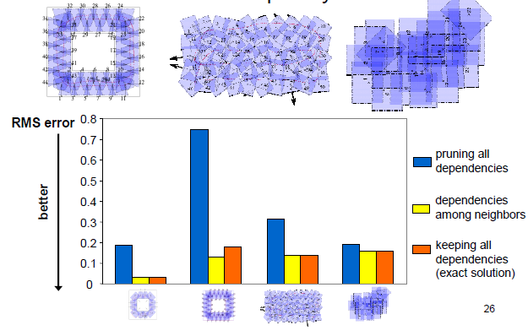
Results: Model Complexity vs. Accuracy

